Slide 1
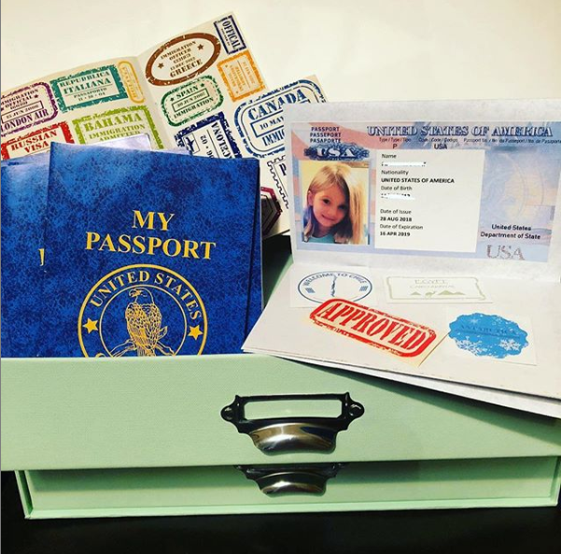
United States
Passport Templates
To be used with the STEM Explorers Curriculum!

Slide 2
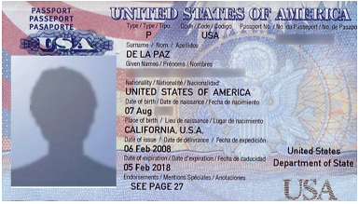
Directions:
Add child’s information where indicated below.
Add students’ pictures or self portrait illustrations in the boxes on the left.
Print and paste into passports like these from Oriental Trading Company, or make your own using the following pages.
If making your own, print and fold in half length-wise; then fold in half width-wise. Staple page 4 inside of page 3 to make a passport book. Paste the passport information below inside the front cover where indicated.
Name
--------------
Nationality
UNITED STATES OF AMERICA
Date of Birth
--/--/----
Date of Issue
---------
Date of Expiration
---------
Name
--------------
Nationality
UNITED STATES OF AMERICA
Date of Birth
--/--/----
Date of Issue
---------
Date of Expiration
---------
Name
--------------
Nationality
UNITED STATES OF AMERICA
Date of Birth
--/--/----
Date of Issue
---------
Date of Expiration
---------

Slide 3
PASSPORT

Slide 4
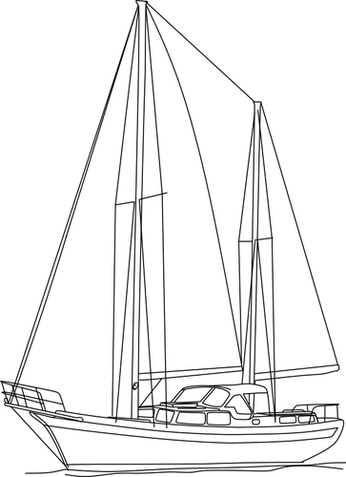

Slide 5
To use the Oriental Trading Company passports with the STEM Explorers curriculum, you will need these “stamps” in addition to the stickers provided with the passports. Print on full-sheet adhesive label paper and cut out stamps for ease of use.

Slide 6
Discover the STEM Explorers Curriculum
Click here to learn more about the global engineering design challenges referred to in this packet.

